Slide 1
BOSTO,MASS
Traveling June 8-15 2013
Planned By:
Alvin

Slide 2
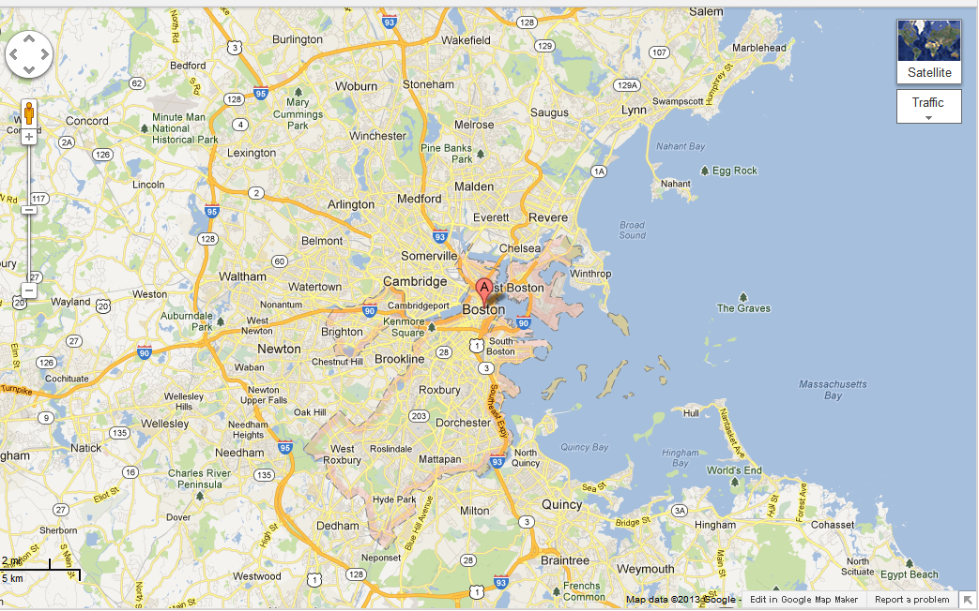
Map

Slide 3
Transportation
Transportation | Budget
Airfare x (family) | $0.00
Airfare Parking at Airport | $151.00
Car Rental | $0.00
Gas (going) [price x 25/ MPG] | $0.00
Gas (coming home) [price x 25/ MPG] | $0.00
Bus Tickets | $0.00
Train | $0.00
Other | $0.00
Total | $0.00
Figure out gas:
Find miles (google Maps)
Divide miles by 25
Take that number x gas price

Slide 4
Lodging
Lodging | Budget
Hotels $ x how many nights http://www.travelocity.com/trips/productDetailsDateless?roomOptions=true&pTxId=2187188&ac_state=MA&guestCounts=1%7C3%2C1%7C1&tabId=information&guestCodes=ADULT%7CCHILD%2CADULT%7CCHILD&propertyIds=4470&childAges=12%7C10%7C3%7C2&city=Boston&configId=S21949757&locLink=HOTELLIST1%7CPOS12&numRooms=2&dest=BOS&path=hotels&hotelRequestId=3119122808316695#details_header Monday Tuesday Wednesday Thursday Friday Saturday | $0.00
Other | $0.00
Total | $0.00

Slide 5
Extra Expense
Extra expenses | Budget
Souvenirs ($0.00 x # of people) x # of purchases | $0.00
Snacks ($0.00 x # of people) x # of purchases | $5.00
Emergency cash | $100
Total | $5.00

Slide 6
Itinerary
Total Expense: $53.00
Saturday, June 8th | Where | How Much?
Breakfast |  | $0.00
Activity | xbox360 | $0.00
Lunch |  | $0.00
Activity | pool | $20.00
Dinner | pizza | $35.00
Activity |  | $0.00

Slide 7
Itinerary
Total Expense: $16.00
Sunday, June 9th | Where | How Much?
Breakfast |  | $0.00
Activity | Paint | $0.00
Lunch | Ramen | $7.00
Activity | Ps3 | $0.00
Dinner |  | $9.00
Activity |  | $0.00

Slide 8
Itinerary
Total Expense: $0.00
Monday, June 10th | Where | How Much?
Breakfast |  | $0.00
Activity |  | $0.00
Lunch |  | $0.00
Activity |  | $0.00
Dinner |  | $0.00
Activity |  | $0.00

Slide 9
Itinerary
Total Expense: $0.00
Tuesday, June 11th | Where | How Much?
Breakfast |  | $0.00
Activity |  | $0.00
Lunch |  | $0.00
Activity |  | $0.00
Dinner |  | $0.00
Activity |  | $0.00

Slide 10
Itinerary
Total Expense: $0.00
Wednesday, June 12th | Where | How Much?
Breakfast |  | $0.00
Activity |  | $0.00
Lunch |  | $47.00
Activity |  | $0.00
Dinner |  | $0.00
Activity |  | $0.00

Slide 12
Itinerary
Total Expense: $0.00
Thursday, June 13th | Where | How Much?
Breakfast |  | $0.00
Activity |  | $0.00
Lunch |  | $0.00
Activity |  | $0.00
Dinner |  | $0.00
Activity |  | $0.00

Slide 13
Itinerary
Total Expense: $0.00
Friday, June 14th | Where | How Much?
Breakfast |  | $0.00
Activity |  | $0.00
Lunch |  | $0.00
Activity |  | $0.00
Dinner |  | $0.00
Activity |  | $0.00

Slide 14
Itinerary
Total Expense: $0.00
Saturday, June 15th | Where | How Much?
Breakfast |  | $0.00
Activity |  | $0.00
Lunch |  | $0.00
Activity |  | $0.00
Dinner |  | $0.00
Activity |  | $0.00

