Slide 1
Paris, France
Traveling June 8-15 2013
Planned By:
Amanda D.

Slide 2
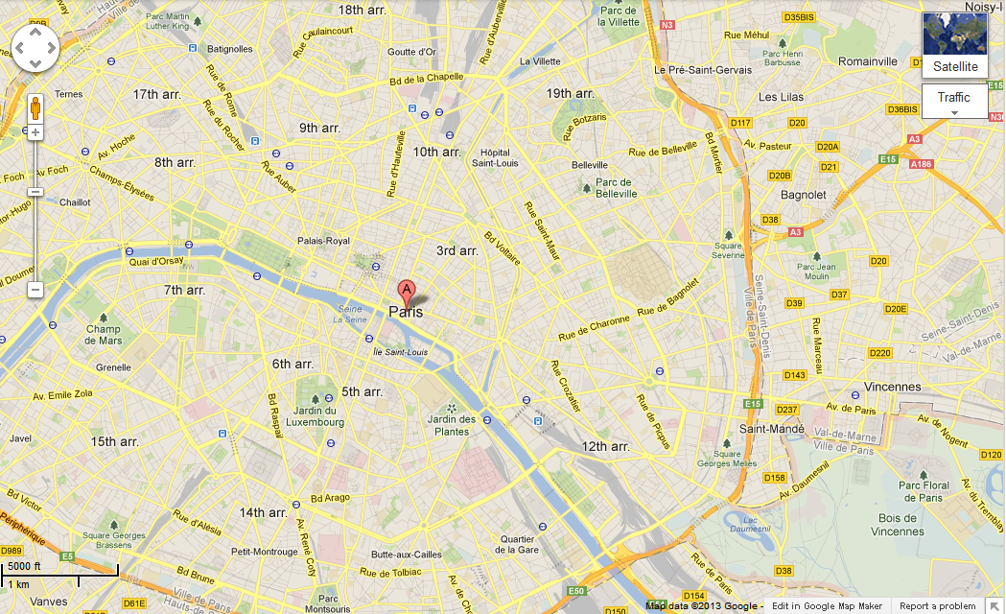
Map

Slide 3
Transportation
Transportation | Budget
Airfare 1,306x 4(family) | $5,224
Airfare Parking at Airport | $0.00
Car Rental | $0.00
Gas (going) [price x 25/ MPG] | $0.00
Gas (coming home) [price x 25/ MPG] | $0.00
Bus Tickets | $0.00
Train | $0.00
Other | $0.00
Total | $5,224
Figure out gas:
Find miles (google Maps)
Divide miles by 25
Take that number x gas price

Slide 4
Lodging
Lodging | Budget
The Westin Paris Vendome $3,735x 6 Not staying in the same place? Sunday Monday Tuesday Wednesday Thursday Friday Saturday | $22,410
Other | $0.00
Total | $0.00

Slide 5
Extra Expense
Extra expenses | Budget
Souvenirs ($20.00 x 4of people) x 7 of purchases | $420
Snacks ($10.00 x 4 of people) x 14 of purchases | $560
Emergency cash | $600
Total | $1580

Slide 6
Itinerary
Total Expense:$116
Saturday, June 8th | Where | How Much?
Breakfast | At home | $0.00
Activity | Plane trip | $0.00
Lunch | Airport restaurant Wendy’s 7x4= 28 | $28.00
Activity | Plane trip | $0.00
Dinner | Little Hanoi 22x4=88 | $88.00
Activity | Swim in hotel pool | $0.00

Slide 7
Itinerary
Total Expense: $2,820
Sunday, June 9th | Where | How Much?
Breakfast | Le Village Russe 82x4=328 | $328
Activity | Musee du Louvre 45x4=180 | $180
Lunch | Le Cinq 500x4=2000 | $2,000
Activity | Luxembourg gardens 0x4=0 | $0.00
Dinner | Blueberry 78x4=312 | $312
Activity | Go home | $0.00

Slide 8
Itinerary
Total Expense: $880
Monday, June 10th | Where | How Much?
Breakfast | Hotel Breakfast 20x4=80 | $80
Activity | Arc De Triomphe 15x2=30+ 10=40 5x2=10 | $40
Lunch | L'estrapade 65x4=260 | $260
Activity | Swim in Pool | $0.00
Dinner | Hotel Dinner 30x4=120 | $120
Activity | Night Swim | $0.00

Slide 9
Itinerary
Total Expense: $1748
Tuesday, June 11th | Where | How Much?
Breakfast | Les Ambassadeurs 246x4=984 | $984
Activity | Eiffel Tower 15x4=60 | $60
Lunch | Picnic (Groceries) 20x4=80 | $80
Activity | Eiffel Tower | $60
Dinner | Les Papilles 141x4=564 | $564
Activity | Go home | $0.00

Slide 10
Itinerary
Total Expense: $0.00
Wednesday, June 12th | Where | How Much?
Breakfast | Hotel Breakfast | $80
Activity | Musee de l’ | $0.00
Lunch |  | $0.00
Activity |  | $0.00
Dinner |  | $0.00
Activity |  | $0.00

Slide 11
Itinerary
Total Expense: $0.00
Thursday, June 13th | Where | How Much?
Breakfast |  | $0.00
Activity |  | $0.00
Lunch |  | $0.00
Activity |  | $0.00
Dinner |  | $0.00
Activity |  | $0.00

Slide 12
Itinerary
Total Expense: $0.00
Friday, June 14th | Where | How Much?
Breakfast |  | $0.00
Activity |  | $0.00
Lunch |  | $0.00
Activity |  | $0.00
Dinner |  | $0.00
Activity |  | $0.00

Slide 13
Itinerary
Total Expense: $0.00
Saturday, June 15th | Where | How Much?
Breakfast |  | $0.00
Activity |  | $0.00
Lunch |  | $0.00
Activity |  | $0.00
Dinner |  | $0.00
Activity |  | $0.00

