Slide 1
Destin, Florida beach
Traveling June 8-15 2013
Planned By:
Cindy Carmona

Slide 2
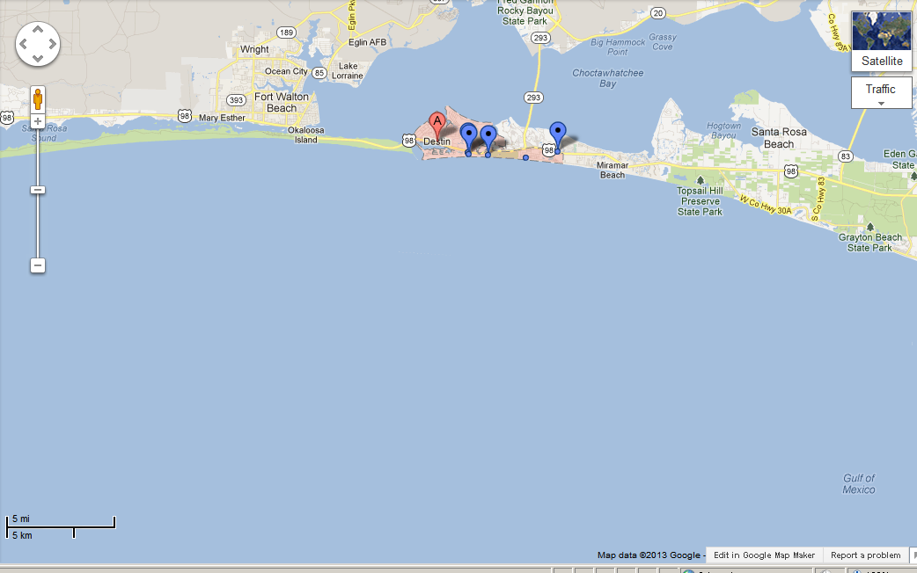
Map

Slide 3
Transportation
Transportation | Budget
Airfare x (family) | $0.00
Airfare Parking at Airport | $0.00
Car Rental | $0.00
Gas (going) [price x 25/ MPG] $4.00x5 | $20.00
Gas (coming home) [price x 25/ MPG] $5.00x5 | $25.00
Bus Tickets | $0.00
Train | $0.00
Other | $0.00
Total | $45.00
Figure out gas:
Find miles (Google Maps)
Divide miles by 25
Take that number x gas price

Slide 4
Lodging
Lodging | Budget
Hotels $500.00 x 7 how many nights Dunes of Seagrove Condominiums by Resort Quest $302.00x5 Not staying in the same place? Sunday Monday Tuesday Wednesday Thursday Friday Saturday | $3,000.00
Other | $0.00
Total | $3,000.00

Slide 5
Extra Expense
Extra expenses | Budget
Souvenirs ($25.00 x4 of people) x 4 of purchases | $100.00
Snacks ($15.00 x 4of people) x 5 of purchases | $60.00
Emergency cash | $700.00
Total | $860.00

Slide 6
Itinerary
Total Expense: $17.15
Saturday, June 8th | Where | How Much?
Breakfast | Waffels | $2.15
Activity | Beach | $0.00
Lunch | Rice and others | $15.00
Activity | fishing | $0.00
Dinner | Rice and others | $.00
Activity | Walk on beach | $0.00

Slide 7
Itinerary
Total Expense: $172.00
Sunday, June 9th | Where | How Much?
Breakfast | Cereal | $4.00
Activity | Beach | $0.00
Lunch | Mcdonalds $21.00x4 | $84.00
Activity | pool | $0.00
Dinner | Pampano Joe’s | $84.00
Activity | fishing | $0.00

Slide 8
Itinerary
Total Expense: $75.00
Monday, June 10th | Where | How Much?
Breakfast | Rice and others | $15.00
Activity | Beach | $0.00
Lunch | Sandwich | $25.00
Activity | Fishing | $0.00
Dinner | Rice and others | $15.00
Activity | walk | $0.00

Slide 9
Itinerary
Total Expense: $84.00
Tuesday, June 11th | Where | How Much?
Breakfast | Cereal | $0.00
Activity | Beach | $0.00
Lunch | Sandwich | $0.00
Activity | Pool | $0.00
Dinner | Pampano Joe’s | $84.00
Activity | fishing | $0.00

Slide 10
Itinerary
Total Expense: $15.00
Wednesday, June 12th | Where | How Much?
Breakfast | Waffles | $0.00
Activity | Beach | $0.00
Lunch | Sandwich | $0.00
Activity | Pool | $0.00
Dinner | Rice and others | $15.00
Activity | Walk and fishing | $0.00

Slide 11
Itinerary
Total Expense: $15.00
Thursday, June 13th | Where | How Much?
Breakfast | Cereal | $0.00
Activity | Beach | $0.00
Lunch | Rice and others | $0.00
Activity | pool | $0.00
Dinner | Rice and others | $0.00
Activity | Fishing and walking | $0.00

Slide 12
Itinerary
Total Expense: $15.00
Friday, June 14th | Where | How Much?
Breakfast | Cereal | $0.00
Activity | Beach | $0.00
Lunch | Sandwich | $0.00
Activity | Pool | $0.00
Dinner | Rice and others | $15.00
Activity | fishing | $0.00

Slide 13
Itinerary
Total Expense: $84.00
Saturday, June 15th | Where | How Much?
Breakfast | Waffels | $0.00
Activity | Baech | $0.00
Lunch | Sandwich | $0.00
Activity | Pool | $0.00
Dinner | Pampano Joe’s | $84.00
Activity | fishing | $0.00

