Slide 1
Myrtle beach ,South caralina
Traveling June 8-15 2013
Planned By:
Colleen D

Slide 2
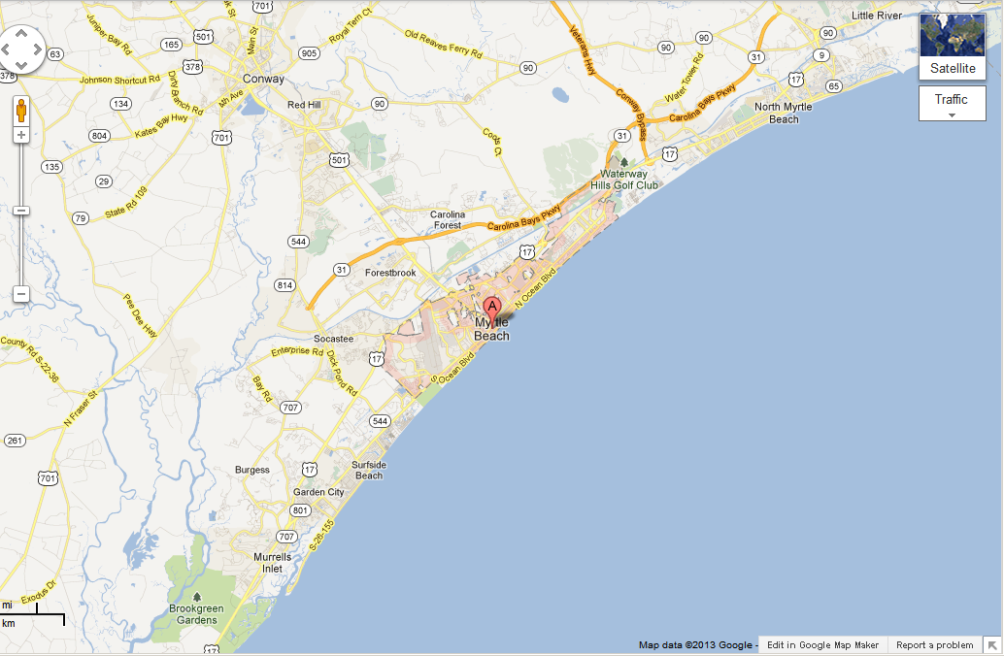
Map

Slide 3
Transportation
Transportation | Budget
Airfare x (family) | $0.00
Airfare Parking at Airport | $0.00
Car Rental | $0.00
Gas (going) [price x 25/ MPG] | $46.75
Gas (coming home) [price x 25/ MPG] | $0.00
Bus Tickets | $0.00
Train | $0.00
Other | $0.00
Total | $0.00
Figure out gas:
Find miles (google Maps)
Divide miles by 25 351
Take that number x gas price

Slide 4
Lodging
Lodging | Budget
Hotels $ x how many nights Beach house 570 x 5 Not staying in the same place? Sunday driving Monday beach house Tuesday beach house Wednesday beach house Thursday beach house Friday beach house Saturday driving | $2,850.00
Other gulf cart | $100.00
Total | $2950.00

Slide 5
Extra Expense
Extra expenses | Budget
Souvenirs ($5.00 x #12of people) x 2 of purchases | $120.00
Snacks ($10.00 x 12 of people) x 4 of purchases | $0.00
Emergency cash | $0.00
Total | $0.00

Slide 6
Itinerary
Total Expense: $0.00
Saturday, June 8th | Where | How Much?
Breakfast | At home | $0.00
Activity | Riding in car | $0.00
Lunch | Made our lunch | $0.00
Activity | Riding in golf that we rented for whole week | $50.00
Dinner | Made it | $0.00
Activity | Swimming at pool | $0.00

Slide 7
Itinerary
Total Expense: $180.00
Sunday, June 9th | Where | How Much?
Breakfast | Chicki fly 12 15 | $180.00
Activity | Ride the golf cart | $0.00
Lunch | made | $0.00
Activity | Went to beach | $0.00
Dinner | Chicken wings | $0.00
Activity | Watched movie | $0.00

Slide 8
Itinerary
Total Expense: $0.00
Monday, June 10th | Where | How Much?
Breakfast | place | $0.00
Activity | Decorate golf cart | $0.00
Lunch | there | $0.00
Activity | parade | $0.00
Dinner | Sea food | $20.00
Activity | Golf cart | $0.00

Slide 9
Itinerary
Total Expense: $36`.00
Tuesday, June 11th | Where | How Much?
Breakfast | there | $0.00
Activity | Golfing 12x3 | $36.00
Lunch | there | $0.00
Activity | pool | $0.00
Dinner | there | $0.00
Activity | pool | $0.00

Slide 10
Itinerary
Total Expense: $0.00
Wednesday, June 12th | Where | How Much?
Breakfast | there | $0.00
Activity | pool | $0.00
Lunch | there | $0.00
Activity | beach | $0.00
Dinner | there | $0.00
Activity | Golf cart | $0.00

Slide 11
Itinerary
Total Expense: $0.00
Thursday, June 13th | Where | How Much?
Breakfast | there | $0.00
Activity |  | $0.00
Lunch |  | $0.00
Activity |  | $0.00
Dinner |  | $0.00
Activity |  | $0.00

Slide 12
Itinerary
Total Expense: $0.00
Friday, June 14th | Where | How Much?
Breakfast |  | $0.00
Activity |  | $0.00
Lunch |  | $0.00
Activity |  | $0.00
Dinner |  | $0.00
Activity |  | $0.00

Slide 13
Itinerary
Total Expense: $0.00
Saturday, June 15th | Where | How Much?
Breakfast |  | $0.00
Activity |  | $0.00
Lunch |  | $0.00
Activity |  | $0.00
Dinner |  | $0.00
Activity |  | $0.00

