Slide 1
Breckenridge, Colorado
Traveling June 8-15 2013
Planned By:
Erin Elizabeth E.

Slide 2
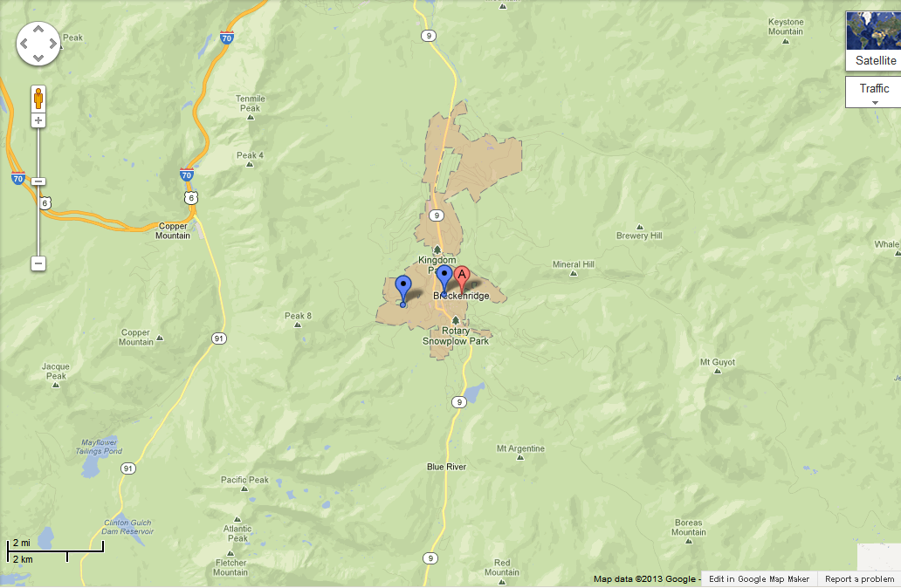
Map

Slide 3
Transportation
Transportation | Budget
Airfare x (family) | $0.00
Airfare Parking at Airport | $0.00
Car Rental | $0.00
Gas (going) [price x 25/ MPG] | $1,073.09
Gas (coming home) [price x 25/ MPG] | $2,828.00
Bus Tickets | $0.00
Train | $0.00
Other | $0.00
Total | $3,901.09
Figure out gas:
Find miles (google Maps)80424
Divide miles by 25 3.517 (CO)
Take that number x gas price

Slide 4
Lodging
Lodging | Budget
Hotels $ x how many nights One Breckenridge Place Townhomes by Great Western Lodging 228x6 Not staying in the same place? Sunday Monday Tuesday Wednesday Thursday Friday Saturday | $1,378.00
Other | $0.00
Total | $1378.00

Slide 5
Extra Expense
Extra expenses | Budget
Souvenirs ($20.00 x 4 of people) x 5 of purchases | $400
Snacks ($10.00 x 4 of people) x 21 of purchases | $840
Emergency cash | $1,000
Total | $2,240

Slide 6
Itinerary
Total Expense: $80.00
Saturday, June 8th | Where | How Much?
Breakfast | Breakfast at home | $0.00
Activity | Driving | $0.00
Lunch | Wendy’s 10x4 | $40 .00
Activity | Driving | $0.00
Dinner | Chick-Fillet 10x4 | $40.00
Activity | Driving | $0.00

Slide 7
Itinerary
Total Expense: $828.00
Sunday, June 9th | Where | How Much?
Breakfast | At hotel 5x4 | $20.00
Activity | Skiing 40x4 | $160.00
Lunch | McDonald’s 7x4 | $28.00
Activity | Walk around town | $0.00
Dinner | Sevens at Breckenridge 100x4 | $400.00
Activity | Go to Cold stone and get ice cream 10x4 | $40.00

Slide 8
Itinerary
Total Expense: $500.00
Monday, June 10th | Where | How Much?
Breakfast | Le Petit Paris 25x4 | $100.00
Activity | Walk around town | $0.00
Lunch | Empire Burger 10x4 | $40.00
Activity | Hike on reserve 30x4 | $120.00
Dinner | Ember 40x4 | $160.00
Activity | Ice Cream at Cold Stone 10x4 | $40.00

Slide 9
Itinerary
Total Expense: $400.00
Tuesday, June 11th | Where | How Much?
Breakfast | At hotel 5x4 | $20.00
Activity | Breckenridge Golf Club 50x4 | $200.00
Lunch | At Hotel 5x4 | $20.00
Activity | Go to Pikes Peak 10x4 | $40.00
Dinner | Dinner service in our hotel 20x4 | $80.00
Activity | Cold Stone ice cream 10x4 | $40.00

Slide 10
Itinerary
Total Expense: $640.00
Wednesday, June 12th | Where | How Much?
Breakfast | At hotel 5x4 | $20.00
Activity | Breckenridge Stables 100x4 | $400.00
Lunch | At hotel 5x4 | $20.00
Activity | Stephen C. West Ice Arena (Breckenridge Ice Rink) 20x4 | $80.00
Dinner | South Ridge Street Seafood Grill 20x4 | $80.00
Activity | Cold Stone ice cream 10x4 | $40.00

Slide 11
Itinerary
Total Expense: $260.00
Friday, June 14th | Where | How Much?
Breakfast | At hotel 5x4 | $20.00
Activity | Peak 8 Fun Park 5x4 | $20.00
Lunch | At hotel 5x4 | $20.00
Activity | Walk around town | $0.00
Dinner | Hearthstone Restaurant 40x4 | $160.00
Activity | Cold Stone ice cream 10x4 | $40.00

Slide 12
Itinerary
Total Expense: $320.00
Thursday, June 13th | Where | How Much?
Breakfast | At hotel 5x4 | $20.00
Activity | Peak 8 Fun Park 5x4 | $20.00
Lunch | At hotel 5x4 | $20.00
Activity | Peak 8 Fun Park 5x4 | $20.00
Dinner | Ski Tip Lodge 50x4 | $200.00
Activity | Cold Stone ice cream 10x5 | $40.00

Slide 13
Itinerary
Total Expense: $88.00
Saturday, June 15th | Where | How Much?
Breakfast | At hotel 5x4 | $20.00
Activity | driving | $0.00
Lunch | McDonald's 7x4 | $28.00
Activity | Driving | $0.00
Dinner | Wendy’s 10x4 | $40.00
Activity | Driving | $0.00

