Slide 1
United Kingdom, Doncaster
Traveling June 8-15 2013
Planned By:
Gretchen Taylor

Slide 2
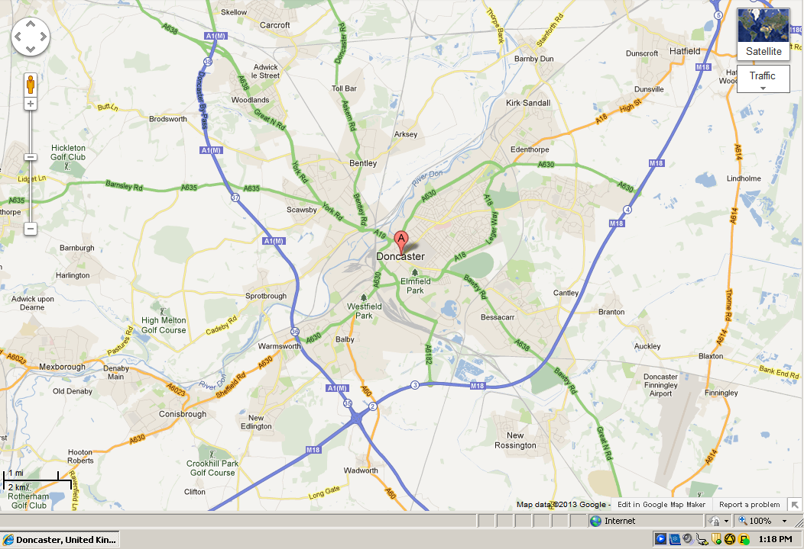
Map

Slide 3
Transportation
Transportation | Budget
Airfare x (family) | $6,512
Airfare Parking at Airport | $0.00
Car Rental | $0.00
Gas (going) [price x 25/ MPG] | $0.00
Gas (coming home) [price x 25/ MPG] | $0.00
Bus Tickets | $0.00
Train | $0.00
Other | $0.00
Total | $0.00
Figure out gas:
Find miles (Google Maps)
Divide miles by 25
Take that number x gas price

Slide 4
Lodging
Lodging | Budget
Hotels $ x how many nights Hi Express Hull City Centre! $89.00 $534.00 Not staying in the same place? Sunday Monday Tuesday Wednesday Thursday Friday Saturday | $534
Other | $0.00
Total | $534

Slide 5
Extra Expense
Extra expenses | Budget
Souvenirs ($10.00 x 4) x 2 | $80.00
Snacks ($5.00 x4) x 3 | $80.00
Emergency cash | $300.00
Total | $460.00

Slide 6
Itinerary
Total Expense: $106.00
Saturday, June 8th | Where | How Much?
Breakfast | Hotel | $300.00
Activity | Yorkshire Wildlife Park | $70.00
Lunch | Hotel | $0.00
Activity | Brodsworth Hall and Gardens | $36.00
Dinner | Hotel | $0.00
Activity |  | $0.00

Slide 7
Itinerary
Total Expense: $18.00
Sunday, June 9th | Where | How Much?
Breakfast | Hotel | $0.00
Activity | swimming | $0.00
Lunch | Hotel | $0.00
Activity | Aeroventure | $18.00
Dinner | Hotel | $0.00
Activity | swimming | $0.00

Slide 8
Itinerary
Total Expense: $24.00
Monday, June 10th | Where | How Much?
Breakfast | Hotel | $0.00
Activity | Markham Grange Steam Museum | FREE
Lunch | Hotel | $0.00
Activity | Doncaster Greyhound Racing | $24.00
Dinner | Hotel | $0.00
Activity | swimming | $0.00

Slide 9
Itinerary
Total Expense: $0.00
Tuesday, June 11th | Where | How Much?
Breakfast | Hotel | $0.00
Activity | swimming | $0.00
Lunch | Hotel | $0.00
Activity |  | $0.00
Dinner | Hotel | $0.00
Activity | swimming | $0.00

Slide 10
Itinerary
Total Expense: $0.00
Wednesday, June 12th | Where | How Much?
Breakfast | Hotel | $0.00
Activity |  | $0.00
Lunch | Hotel | $0.00
Activity |  | $0.00
Dinner | Hotel | $0.00
Activity | swimming | $0.00

Slide 11
Itinerary
Total Expense: $0.00
Thursday, June 13th | Where | How Much?
Breakfast | Hotel | $0.00
Activity | swimming | $0.00
Lunch | Hotel | $0.00
Activity | Doncaster Dome | $0.00
Dinner | Hotel | $0.00
Activity | swimming | $0.00

Slide 12
Itinerary
Total Expense: $0
Friday, June 14th | Where | How Much?
Breakfast | Hotel | $0.00
Activity | swimming | $0.00
Lunch | Hotel | $0.00
Activity | swimming | $0.00
Dinner | Hotel | $0.00
Activity | swimming | $0.00

Slide 13
Itinerary
Total Expense: $0
Saturday, June 15th | Where | How Much?
Breakfast | Hotel | $0.00
Activity | swimming | $0.00
Lunch | Hotel | $0.00
Activity | swimming | $0.00
Dinner | Hotel | $0.00
Activity | swimming | $0.00

