Slide 1
Myrtle beach, south carolina
Traveling June 8-15 2013
Planned By:
heidi

Slide 2
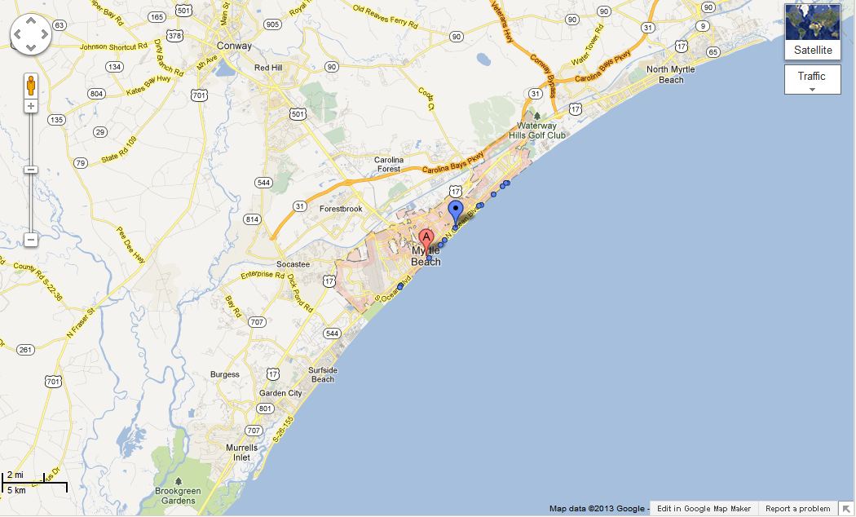
Map

Slide 3
Transportation
Transportation | Budget
Airfare x (family) | $0.00
Airfare Parking at Airport | $0.00
Car Rental | $0.00
Gas (going) [price x 25/ MPG] | $4.67
Gas (coming home) [price x 25/ MPG] | $14.48
Bus Tickets | $0.00
Train | $0.00
Other | $0.00
Total | $0.00
Figure out gas:
Find miles (google Maps)
Divide miles by 25
Take that number x gas price

Slide 4
Lodging
Lodging | Budget
Hotels $ x how many nights Sea Crest Ocean Front Resort $95.00 Not staying in the same place? Sunday Monday Tuesday Wednesday Thursday Friday Saturday | $1,235.00
Other | $0.00
Total | $1,235.00

Slide 5
Extra Expense
Extra expenses | Budget
Souvenirs ($39.00x # of people) x # of purchases | $100.00
Snacks ($6.78x # of people) x # of purchases | $10.00
Emergency cash | $700
Total | $810

Slide 6
Itinerary
Total Expense:$64.00
Saturday, June 8th | Where | How Much?
Breakfast | I hope 4x7 | $28.00
Activity | Beach | $0.00
Lunch | KFC 4x7 | 28.00
Activity | Swimming in hotel pool | $0.00
Dinner | Seafood 4x7 | $28.00
Activity | Walk on bridge | $0.00

Slide 7
Itinerary
Total Expense: $56.00
Tuesday, June 11th | Where | How Much?
Breakfast | Waffle house 4x7 | $ 28.00
Activity | Walk on Beach | $0.00
Lunch | KFC 4x7 | $0.00
Activity | Collect seashells | $0.00
Dinner | Long Horn4x7 | $28.00
Activity | golfing | $0.00

Slide 8
Itinerary
Total Expense: $56.00
Wednesday, June 12th | Where | How Much?
Breakfast | I Hope 4X7 | $28.00
Activity | POOL | $0.00
Lunch | EGGS | $0.00
Activity | POOL | $0.00
Dinner | LONG HORN 4X7 | $28.00
Activity | GOLF | $0.00

Slide 9
Itinerary
Total Expense: $0.00
Thursday, June 13th | Where | How Much?
Breakfast | Eating at hotel | $0.00
Activity | beach | $0.00
Lunch | sandwich | $0.00
Activity | pool | $0.00
Dinner | pizza | $0.00
Activity | pool | $0.00

Slide 10
Itinerary
Total Expense: $0.00
Friday, June 14th | Where | How Much?
Breakfast | sandwich | $0.00
Activity | golf | $0.00
Lunch | sandwich | $0.00
Activity | Go to fair | $0.00
Dinner | pizza | $0.00
Activity | pool | $0.00

Slide 11
Itinerary
Total Expense: $0.00
Saturday, June 15th | Where | How Much?
Breakfast | juice | $0.00
Activity | pool | $0.00
Lunch | eggs | $0.00
Activity | stores | $0.00
Dinner | subway | $0.00
Activity | beach | $0.00

