Slide 1
Orlando, Florida
Traveling June 8-15 2013
Planned By:
Hillary A.

Slide 2
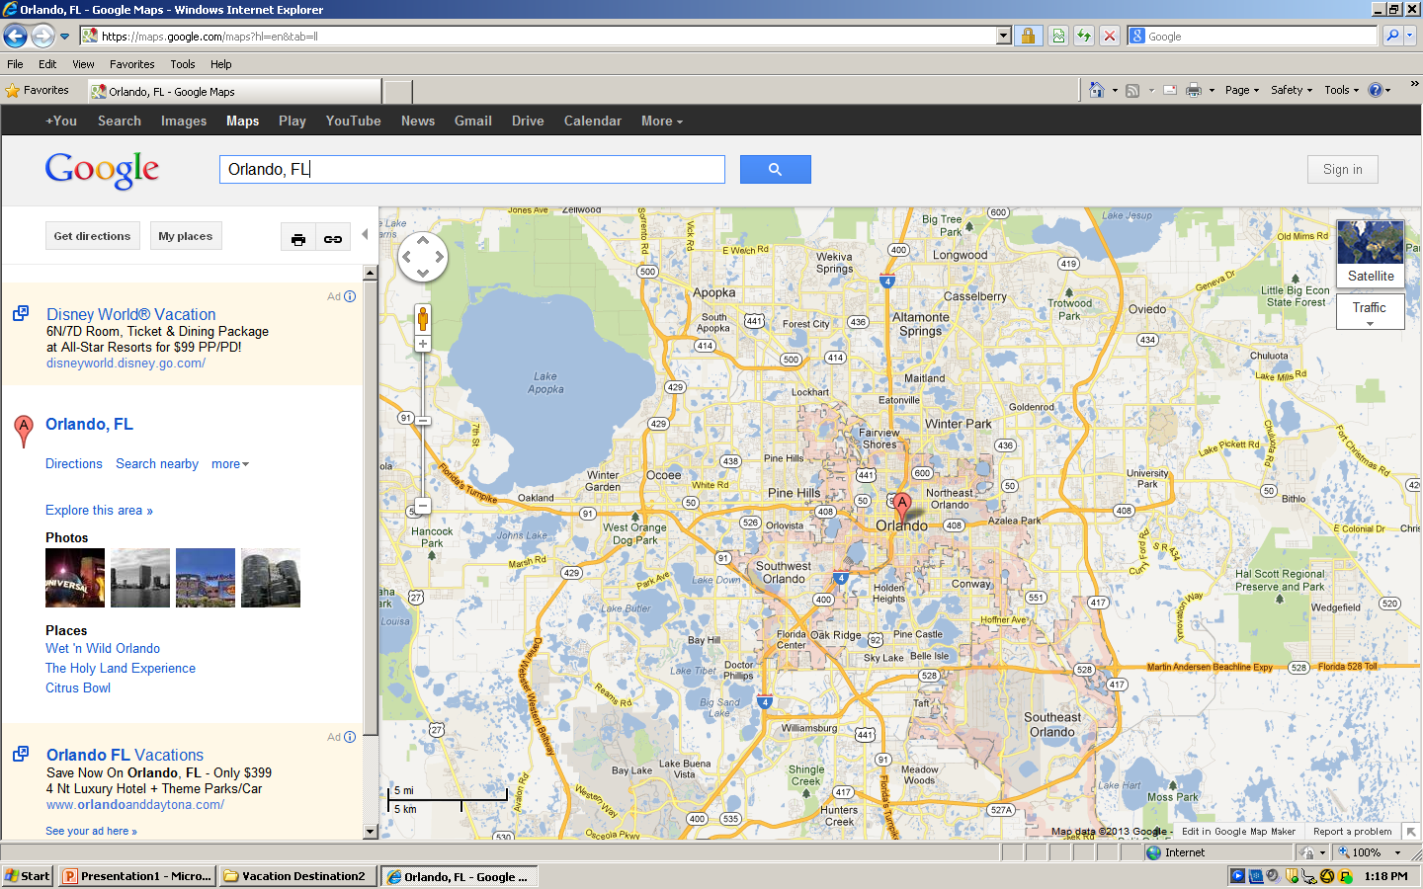
Map

Slide 3
Transportation
Transportation | Budget
Airfare 140x3 | $420.00
Airfare Parking at Airport | $0.00
Car Rental | $0.00
Gas (going) [price x 25/ MPG] | $0.00
Gas (coming home) [price x 25/ MPG] | $0.00
Bus Tickets | $0.00
Train | $0.00
Other | $0.00
Total | $420.00
Figure out gas:
Find miles (google Maps)
Divide miles by 25
Take that number x gas price

Slide 4
Lodging
Lodging | Budget
Hotels $ x how many nights Hilton Orlando 309.000x6 Not staying in the same place? Sunday Monday Tuesday Wednesday Thursday Friday Saturday | $1854.00
Other | $0.00
Total | $1854.00

Slide 5
Extra Expense
Extra expenses | Budget
Souvenirs (400.00 x 3 of people) x 7 of purchases | $8400.00
Snacks (300x 3of people) x 14 of purchases | $12000.00
Emergency cash | $20000.00
Total | $40400.00

Slide 6
Itinerary
Total Expense: $4303.68
Saturday, June 8th | Where | How Much?
Breakfast | McDonald's 3x7 | $0.00
Activity | Hollywood Studios 3x 120 | $1108.68
Lunch | Earl of Sandwich, 3x10 | $30.00
Activity | Pirates cove 3x5 | $15.00
Dinner | Victoria & Albert's, 3x60 | $180.00
Activity | Swim at Hotel Pool | $0.00

Slide 7
Itinerary
Total Expense: $191.00
Sunday, June 9th | Where | How Much?
Breakfast | KFC 3x7 | $21.00
Activity | Magic Kingdom 3x0 | $0.00
Lunch | Pizzafari 3x20 | $60.00
Activity | Chatham's Place . | $80.00
Dinner | Aloha Isle at Magic Kingdom . 3x10 | $30.00
Activity | Swim at pool | $0.00

Slide 8
Itinerary
Total Expense: $711.00
Monday, June 10th | Where | How Much?
Breakfast | McDonalds 3x7 | $21.00
Activity | Blizzard Beach 3x0 | $0.00
Lunch | Seasons 52 . 3x50 | $150.00
Activity | Sea world 3x0 | $0.00
Dinner | Chatham's Place . 3x80 | $240.00
Activity | Wishes Fireworks 3x100 | $300.00

Slide 9
Itinerary
Total Expense: $441.00
Tuesday, June 11th | Where | How Much?
Breakfast | KFC 3x7 | $21.00
Activity | Epcot 3x0 | $0.00
Lunch | Tony Roma's Ribs, Seafood, & Steaks 3x20 | $60.00
Activity | Typoon lagoon 3x0 | $0.00
Dinner | Victoria & Albert's . 3x120 | $360.00
Activity | Swim at Pool 3x0 | $0.00

Slide 10
Itinerary
Total Expense: $231.00
Wednesday, June 12th | Where | How Much?
Breakfast | McDonalds 3x7 | $21.00
Activity | Fun Spot 3x60 | $180.00
Lunch | Chili's Bar & Grill - S Apopka Vineland Rd 3x30 | $90.00
Activity | Swim at pool 3x0 | $0.00
Dinner | Chatham's Place . 3x80 | $0.00
Activity | Swim at pool 3x0 | $0.00

Slide 11
Itinerary
Total Expense: $0.00
Thursday, June 13th | Where | How Much?
Breakfast | Keke's Breakfast Café 3x10 | $30.00
Activity |  | $0.00
Lunch |  | $0.00
Activity |  | $0.00
Dinner |  | $0.00
Activity |  | $0.00

Slide 12
Itinerary
Total Expense: $0.00
Friday, June 14th | Where | How Much?
Breakfast |  | $0.00
Activity |  | $0.00
Lunch |  | $0.00
Activity |  | $0.00
Dinner |  | $0.00
Activity |  | $0.00

Slide 13
Itinerary
Total Expense: $0.00
Saturday, June 15th | Where | How Much?
Breakfast |  | $0.00
Activity |  | $0.00
Lunch |  | $0.00
Activity |  | $0.00
Dinner |  | $0.00
Activity |  | $0.00

