Slide 1
Orlando Florida
Traveling June 8-15 2013
Planned By:
Jason lara

Slide 2
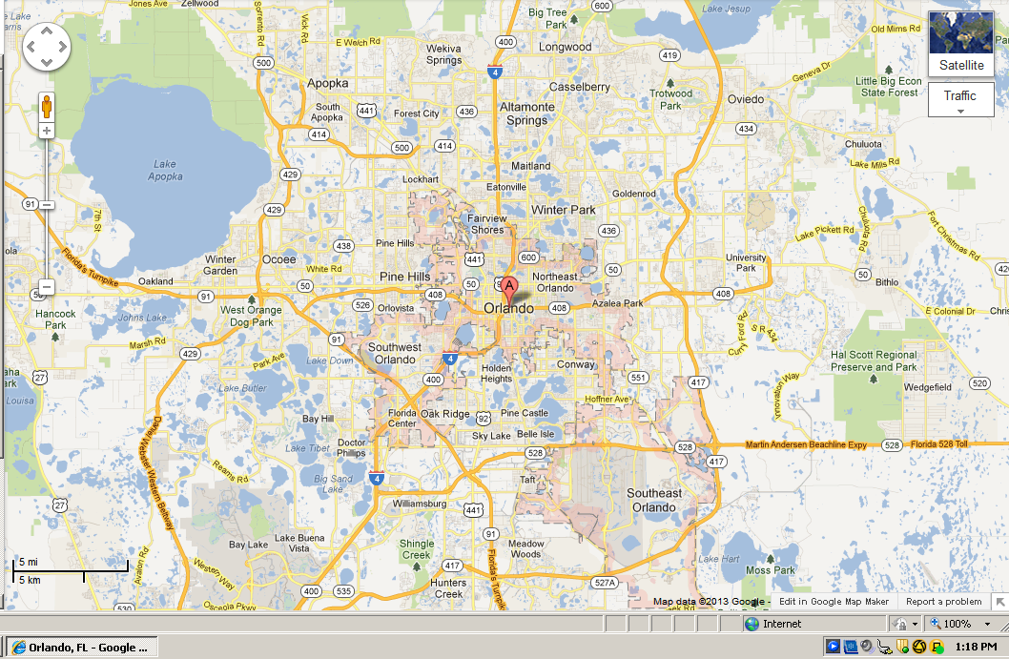
Map

Slide 3
Transportation
Transportation | Budget
Airfare x (family) | $0.00
Airfare Parking at Airport | $0.00
Car Rental | $0.00
Gas (going) [price x 25/ MPG] | $0.00
Gas (coming home) [price x 25/ MPG] | $0.00
Bus Tickets | $0.00
Train | $0.00
Other | $0.00
Total | $0.00
Figure out gas:3.333
Find miles (google Maps)
Divide miles469 by 25
Take that number x gas price

Slide 4
Lodging
Lodging | Budget
Hotels $159 x 6 how many nights Walt Disney World Swan Not staying in the same place? Sunday Monday Tuesday Wednesday Thursday Friday Saturday | $954.00
Other | $0.00
Total | $0.00

Slide 5
Extra Expense
Extra expenses | Budget
Souvenirs ($50.00 x 4 of people) x # of purchases | $200.00
Snacks ($10.00 x 4 of people) x # of purchases | $40.00
Emergency cash | $500.00
Total | $

Slide 6
Itinerary
Total Expense: $0.00
Saturday, June 8th | Where | How Much?
Breakfast | McDonald's | $28.00
Activity | Magic Kingdom, | $40.00
Lunch | San Angel Inn | $140.00
Activity | fair | $40.00
Dinner | Mama Melrose's Restaurant Italiano | $52.00
Activity | Downtown Disney, | $30.00

Slide 7
Itinerary
Total Expense: $0.00
Sunday, June 9th | Where | How Much?
Breakfast |  | $0.00
Activity | Disney's Animal Kingdom, | $50.00
Lunch |  | $0.00
Activity | Magic Kingdom | $40.00
Dinner | Panda Express 13x4 | $52.00
Activity | Disney's Hollywood Studios | $30.00

Slide 8
Itinerary
Total Expense: $0.00
Monday, June 10th | Where | How Much?
Breakfast | Hotel breakfast room | $0.00
Activity | Drive back home | $0.00
Lunch |  | $0.00
Activity | Play with my dog | $0.00
Dinner | Quik trip | $10.00
Activity |  | $0.00

Slide 9
Itinerary
Total Expense: $0.00
Tuesday, June 11th | Where | How Much?
Breakfast |  | $0.00
Activity |  | $0.00
Lunch |  | $0.00
Activity |  | $0.00
Dinner |  | $0.00
Activity |  | $0.00

Slide 10
Itinerary
Total Expense: $0.00
Wednesday, June 12th | Where | How Much?
Breakfast |  | $0.00
Activity |  | $0.00
Lunch |  | $0.00
Activity |  | $0.00
Dinner |  | $0.00
Activity |  | $0.00

Slide 11
Itinerary
Total Expense: $0.00
Thursday, June 13th | Where | How Much?
Breakfast |  | $0.00
Activity |  | $0.00
Lunch |  | $0.00
Activity |  | $0.00
Dinner |  | $0.00
Activity |  | $0.00

Slide 12
Itinerary
Total Expense: $0.00
Friday, June 14th | Where | How Much?
Breakfast |  | $0.00
Activity |  | $0.00
Lunch |  | $0.00
Activity |  | $0.00
Dinner |  | $0.00
Activity |  | $0.00

Slide 13
Itinerary
Total Expense: $0.00
Saturday, June 15th | Where | How Much?
Breakfast |  | $0.00
Activity |  | $0.00
Lunch |  | $0.00
Activity |  | $0.00
Dinner |  | $0.00
Activity |  | $0.00

