Slide 1
Orlando , Florida
Traveling July 8-15 2013
Planned By:
Juan L T.

Slide 2
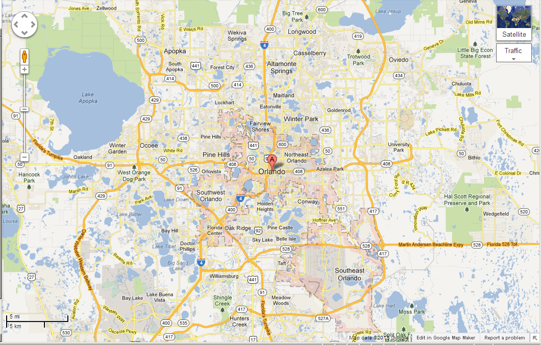
Map

Slide 3
Transportation
Transportation | Budget
Airfare x (family) | $0.00
Airfare Parking at Airport | $0.00
Car Rental | $0.00
Gas (going) [price x 25/ MPG] | $63.70
Gas (coming home) [price x 25/ MPG] | $78.75
Bus Tickets | $0.00
Train | $0.00
Other | $0.00
Total | $142.45
Figure out gas:
Find miles (google Maps)469
Divide miles by 25-18.36
Take that number x gas price63.70

Slide 4
Lodging
Lodging | Budget
Hotels $ x how many nights Nickelodeon suites resort Not staying in the same place? Sunday Monday Tuesday Wednesday Thursday Friday Saturday | $1254.00
Other | $0.00
Total | $1254.00

Slide 5
Extra Expense
Extra expenses | Budget
Souvenirs ($30.00 x 7of people) x 1 of purchases | $210.00
Snacks ($5.00 x 7of people) x 2of purchases | $70.00
Emergency cash | $300.00
Total | $580.00

Slide 6
Itinerary
Total Expense: $14.00
Saturday, June 8th | Where | How Much?
Breakfast | at home | $0.00
Activity | driving | $0.00
Lunch | McDonald’s3x7 | $21.00
Activity | driving | $0.00
Dinner | McDonalds3x7 | $21.00
Activity | sleeping | $0.00

Slide 7
Itinerary
Total Expense: $564.00
Sunday, June 9th | Where | How Much?
Breakfast | At hotel7x3 | $21.00
Activity | Universal Studios160x3 | $480.00
Lunch | Taco Bell3x7 | $21.00
Activity | Universal Studios | $0.00
Dinner | Hotel3x7 | $21.00
Activity | sleeping | $0.00

Slide 8
Itinerary
Total Expense: $63.00
Monday, June 10th | Where | How Much?
Breakfast | McDonalds3x7 | $21.00
Activity | Walk in park | $0.00
Lunch | Hot dog stand3x7 | $21.00
Activity | Walk in City | $0.00
Dinner | Pizza3x7 | $21.00
Activity | sleeping | $0.00

Slide 9
Itinerary
Total Expense: $61.00
Tuesday, June 11th | Where | How Much?
Breakfast | Hotel7x3 | $21.00
Activity | beach | $0.00
Lunch | Burger king3x7 | $21.00
Activity | beach | $0.00
Dinner | hotel7x3 | $21.00
Activity | sleeping | $0.00

Slide 10
Itinerary
Total Expense: $75.00
Wednesday, June 12th | Where | How Much?
Breakfast | hotel7x3 | $21.00
Activity | pool4x3 | $12.00
Lunch | hotel7x3 | $21.00
Activity | pool | $0.00
Dinner | hotel7x3 | $21.00
Activity | sleeping | $0.00

Slide 11
Itinerary
Total Expense: $543.00
Thursday, June 13th | Where | How Much?
Breakfast | hotel | $21.00
Activity | Universal Studios | $480.00
Lunch | hotel | $21.00
Activity | pool | $12.00
Dinner | hotel | $21.00
Activity | sleeping | $0.00

Slide 12
Itinerary
Total Expense: $54.00
Friday, June 14th | Where | How Much?
Breakfast | McDonalds3x7 | $21.00
Activity | rest | $0.00
Lunch | Hotel7x3 | $21.00
Activity | park | $0.00
Dinner | Hotel7x3 | $2100
Activity | sleeping | $0.00

Slide 13
Itinerary
Total Expense: $20.00
Saturday, June 15th | Where | How Much?
Breakfast | sandwich3x7 | $21.00
Activity | driving | $0.00
Lunch | McDonalds3x7 | 2100
Activity | driving | $0.00
Dinner | Rice and spam3x7 | $21.00
Activity | sleeping | $0.00

