Slide 1
Puerto Rico
Traveling June 8-15 2013
Planned By:
Melanie D.

Slide 2
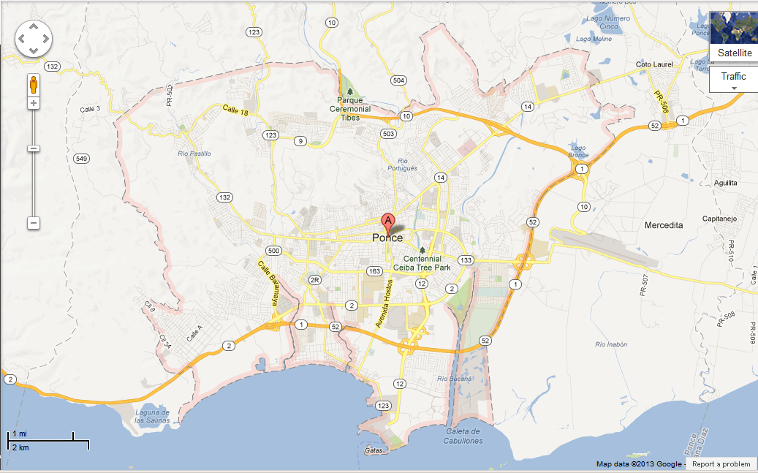
Map

Slide 3
Transportation
Transportation | Budget
465x 9 | $4180.00
Airfare Parking at Airport | $0.00
Car Rental | $0.00
Gas (going) [price x 25/ MPG] | $0.00
Gas (coming home) [price x 25/ MPG] | $0.00
Bus Tickets | $0.00
Train | $0.00
Other | $0.00
Total | $4180.00
Figure out gas:
Find miles (google Maps)
Divide miles by 25
Take that number x gas price

Slide 4
Lodging
Lodging | Budget
Hotels $ x how many nights Holiday Inn Mayaguez Tropical $117.00 x 6 Not staying in the same place? Sunday Monday Tuesday Wednesday Thursday Friday Saturday | $1062.20
Other | $0.00
Total | $1062.20

Slide 5
Extra Expense
Extra expenses | Budget
Souvenirs ($10.00 x 4 of people) x 3 of purchases | $120.00
Snacks ($5.00 x 4 of people) x 7 of purchases | $140.00
Emergency cash | $100.00
Total | $360.00

Slide 6
Itinerary
Total Expense: $180.00
Saturday, June 8th | Where | How Much?
Breakfast | Hotel breakfast | $0.00
Activity | none | $0.00
Lunch | Al Sur Restaurant 20x4 | $80.00
Activity | none | $0.00
Dinner | La Casa Del Chef 25x4 | $100.00
Activity | Walk around | $0.00

Slide 7
Itinerary
Total Expense: $104.00
Sunday, June 9th | Where | How Much?
Breakfast | Hotel breakfast | $0.00
Activity | beach | $0.00
Lunch | Yeyo's Sea Food Restaurant 13x4 | $52.00
Activity | none | $0.00
Dinner | la verdadera casa de las tias 13x4 | $52.00
Activity | Walk at the beach | $0.00

Slide 8
Itinerary
Total Expense: $156.00
Monday, June 10th | Where | How Much?
Breakfast | El Ancla 13x4 | $52.00
Activity | Beach | $0.00
Lunch | El Ancla 13x4 | $52.00
Activity | none | $0.00
Dinner | La Monserrate Sea Port 13x4 | $52.00
Activity | Go to the pool | $0.00

Slide 9
Itinerary
Total Expense: $210.00
Tuesday, June 11th | Where | How Much?
Breakfast | home | $150.00
Activity | beach | $0.00
Lunch | home | $0.00
Activity | pool | $0.00
Dinner | las cucharas 13x4 | $52.00
Activity | Museum of the History of Ponce 3x2 2x1 | $8.00

Slide 10
Itinerary
Total Expense: $0.00
Wednesday, June 12th | Where | How Much?
Breakfast | home | $0.00
Activity | beach | $0.00
Lunch | Home | $0.00
Activity | pool | $0.00
Dinner | home | $0.00
Activity | none | $0.00

Slide 11
Itinerary
Total Expense: $52.00
Thursday, June 13th | Where | How Much?
Breakfast | home | $0.00
Activity | none | $0.00
Lunch | home | $0.00
Activity | beach | $0.00
Dinner | Romano's Macaroni Grill 13x4 | $52.00
Activity | walk | $0.00

Slide 12
Itinerary
Total Expense: $152.00
Friday, June 14th | Where | How Much?
Breakfast | Hotel breakfast | $0.00
Activity | beach | $0.00
Lunch | Lola 13x4 | $52.00
Activity | Museo de Arte de Ponce 4x2 2x2 | $12.00
Dinner | La Cava 13x4 | $52.00
Activity | pool | $0.00

Slide 13
Itinerary
Total Expense: $52.00
Saturday, June 15th | Where | How Much?
Breakfast | hotel | $0.00
Activity | Go to beach | $0.00
Lunch | El Negocio de Panchi 13x4 | $52.00
Activity | none | $0.00
Dinner | home | $0.00
Activity | none | $0.00

