Slide 1
Jersey City, New Jersey Total: $2,759.53
Traveling June 8-15 2013
Planned By:
Theodora A.

Slide 2
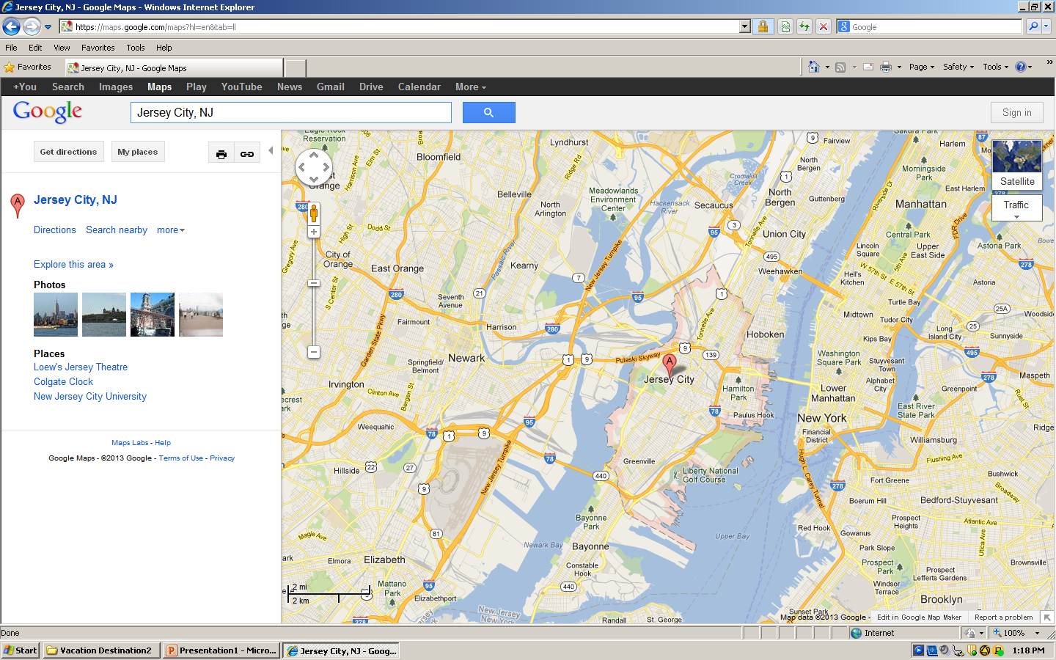
Map

Slide 3
Transportation
Transportation | Budget
Airfare x (family) | $0.00
Airfare Parking at Airport | $0.00
Car Rental | $0.00
Gas (going) [price x 25/ MPG] | $101.59
Gas (coming home) [price x 25/ MPG] | $103.94
Bus Tickets | $0.00
Train | $0.00
Other | $0.00
Total | $232.53
Figure out gas:
Find miles (Google Maps)841
Divide miles by 25/841
Take that number x gas price 3.284

Slide 4
Lodging
Lodging | Budget
Hotels $ x how many nights Not staying in the same place? Sunday Monday Tuesday Wednesday Thursday La Quinta Inn and Suites Clifton $99.00 Friday Saturday | $99.00
Other Bobo’s house $0.00x1 | $0.00
Total | $99.00

Slide 5
Extra Expense
Extra expenses | Budget
Souvenirs ($20.00 x 5 of people) x #7of purchases | $700.00
Snacks ($15.20 x 5of people) x 7 of purchases | $532.00
Emergency cash | $500.00
Total | $1532.00

Slide 6
Itinerary
Total Expense: $300.00
Saturday, June 8th | Where | How Much?
Breakfast | Eat at home Groceries | $300.00
Activity | drive | $0.00
Lunch | Eat packed food | $0.00
Activity | drive | $0.00
Dinner | Eat packed food | $0.00
Activity | drive | $0.00

Slide 7
Itinerary
Total Expense: $252.00
Sunday, June 9th | Where | How Much?
Breakfast | Wonder bagels 13x4 | $52.00
Activity | New York Yankees 50x4 | $200.00
Lunch | At home | $0.00
Activity | Go to park | $0.00
Dinner | At home | $0.00
Activity | none | $0.00

Slide 8
Itinerary
Total Expense: $72.00
Monday, June 10th | Where | How Much?
Breakfast | Macdonald’s13x4 | $52.00
Activity | Liberty science center5x4=20 | $20.00
Lunch | At home | $0.00
Activity | Roller skating at home | $0.00
Dinner | At home | $0.00
Activity | none | $0.00

Slide 9
Itinerary
Total Expense: $92.00
Tuesday, June 11th | Where | How Much?
Breakfast | At home | $0.00
Activity | Ride bikes | $0.00
Lunch | Bertucci's Brick Oven Restaurant 13 x 4 | $52.00
Activity | Calypso Sailing Adventures 10x4 | $40.00
Dinner | At home | $0.00
Activity | walk | $0.00

Slide 10
Itinerary
Total Expense: $100.00
Wednesday, June 12th | Where | How Much?
Breakfast | At home | $0.00
Activity | Bike riding | $0.00
Lunch | Edward's Steak House 25x4 | $100.00
Activity | Liberty State Park | $0.00
Dinner | At home | $0.00
Activity | none | $0.00

Slide 11
Itinerary
Total Expense: $80.00
Thursday, June 13th | Where | How Much?
Breakfast | Soul Flavors20x4 | $80.00
Activity | Empty Sky - 9/11 Memorial | $0.00
Lunch | At home | $0.00
Activity | Roller skate | $0.00
Dinner | At home | $0.00
Activity | none | $0.00

Slide 12
Itinerary
Total Expense: $0.00
Friday, June 14th | Where | How Much?
Breakfast | Packed food | $0.00
Activity | Bobo’s house | $0.00
Lunch | Packed food | $0.00
Activity | drive | $0.00
Dinner | At home | $0.00
Activity | none | $0.00

Slide 13
Itinerary
Total Expense: $0.00
Saturday, June 15th | Where | How Much?
Breakfast | At home | $0.00
Activity | drive | $0.00
Lunch | Packed food | $0.00
Activity | drive | $0.00
Dinner | Packed food | $0.00
Activity | At home | $0.00

